Slide 1

6.17.2019
Flutter Masters
Kevin Ford
e: KevinF@magenic.com
m: 617-259-5192

Slide 2
Class Outline – 17 June 2019 (8 PM – 10 PM eastern)
Introduction presentation
Setup Flutter
Create project on Github
Create First App
Understanding the project structure
What is a view?
Ok a widget
Stateful and Stateless
Managing State

Slide 3
Class Outline – 24 Jun 2019 (6 PM – 10 PM eastern)
Navigation
Pushing and popping screens
Routes
Moving data back and forth
Cross screen animations
Slivers
Gestures

Slide 4
Class Outline – 2 JUL 2019 (6 PM – 10PM eastern)
Layouts
Row
Column
Stack
Index Stack
Gridview
Flow
Table
Wrap
ListView
Expanded

Slide 5
Class Outline – 8 Jul 2019 (6PM – 10PM eastern)
Isolates
Event loops
Asynchronous programming
Futures Streams
Background tasks

Slide 6
Class Outline – 15 Jul 2019 (6PM – 10PM eastern)
State Management
Declarative State
Ephemeral state and app state
State Concepts
setState
Inherited Widgets
Provider and Scoped model

Slide 7
Class Outline – 22 Jul 2019 (6PM – 10PM eastern)
Flutter Inspecter
Timeline View
Memory View
Dart Packages (https://pub.dev)

Slide 8
Flutter History
Unveiled 2015 (Similar to React Native)
Intent of being able to render 120 fps
Version 1.0 Released 4 Dec 2018
Version 1.5 Released 7 May 2019

Slide 9

What is Flutter?

Slide 10

Where Does Flutter Come From?
Backed by Google
Open Source License
Platforms
iOS, Android - First class support
Flutter for Web – Tech Preview
Windows/MacOS, Linux – Limited support

Slide 11


Development
DART
AOT Compiled

Slide 12
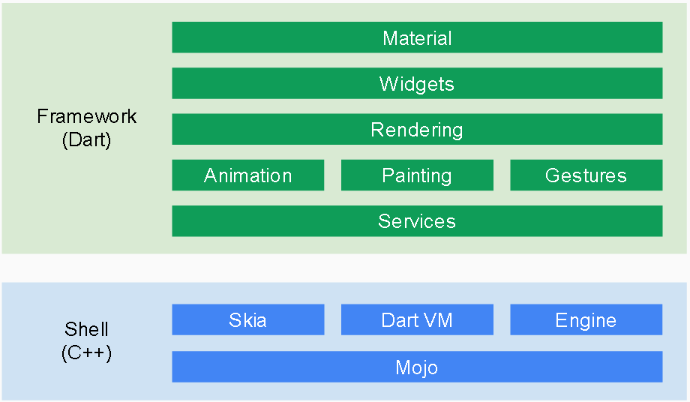

Slide 13
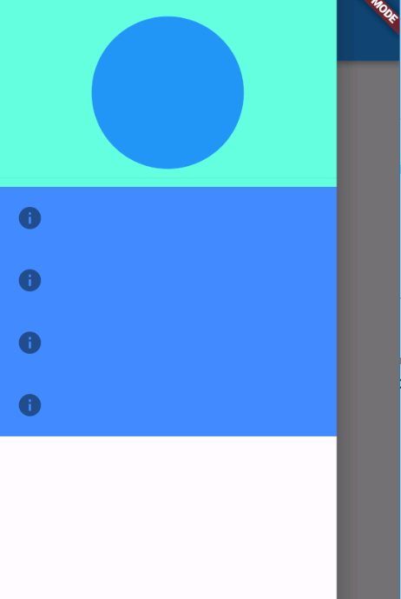
Flutter UIs
Declarative UI
Everything is a widget
Stateless
Stateful
Two Sets
Material Design
Cupertino
build method
Widget Tree
Can create other widget s in the build method
Single thread loop – Isolates
BuildContext – place in the widget tree
Notes:
Everything is completely custom. Not really using the native controls.

Slide 14
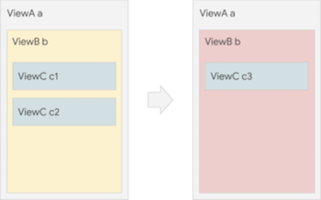
Declarative UI vs Imperative UI
Imperative
b.setColor(red)
b.clearChildren()
ViewC c3 = new ViewC(...) b.add(c3)
Declarative
return ViewB(
color: red,
child: ViewC(...),
)

Slide 15
Stateless Widgets
Used to create “read only” type UI objects
Perhaps an image
A readme label section
The state of the Stateless widget doesn’t change
Can still be redrawn if a parent’s state has changed
Extremely lightweight

Slide 16
Stateless Widget
class MyStatelessWidget extends StatelessWidget {
@override Widget build(BuildContext context) {
return //Do some stuff to draw a UI.
}
}

Slide 17
Stateful widget
Used when the context or state is expected to be changed
React to user input
React to system input
Two classes
StatefulWidget –
The widget that you can place in the widget tree
Thrown away often
State<T> - Created to handle the mutable state
Contains the build method
Long lived

Slide 18
Stateful Widget
class MyStatefulWidget extends StatefulWidget {
MyStatefulWidget({Key key}) : super(key: key);
@override
_MyWidgetState createState() => _MyWidgetState();
}
class _MyWidgetState extends State<MyStatefulWidget> {
@override Widget build(BuildContext context) {
return //Do some stuff to draw a UI.
}
}

Slide 19
Widget Lifecycle
createState()
didUpdateWidget()
initState()
setState()
didChangeDependencies()
deactivate()
Build()
dispose()

Slide 20
Let’s get going
Things to do
Get the flutter SDK
Update Path
Run flutter doctor
Install Android Studio
Setup Emulator
(Optional for MacOS, setup Xcode)
See Windows:
https://flutter.dev/docs/get-started/install/windows
See MacOS
https://flutter.dev/docs/get-started/install/macos

Slide 21
Get an editor
Install
Download / install VSCode
Invoke View > Command Palette….
Type “install”, and select Extensions: Install Extensions.
Type “flutter” in the extensions search field, select Flutter in the list, and click Install. This also installs the required Dart plugin.
Verify
Invoke View > Command Palette….
Type “doctor”, and select the Flutter: Run Flutter Doctor.
Review the output in the OUTPUT pane for any issues.

Slide 22
Create a project
From VSCode
Invoke View > Command Palette.
Type “flutter”, and select the Flutter: New Project.
Enter a project name of flutter_masters, and press Enter.
Create or select the parent directory for the new project folder.
Wait for project creation to complete and the main.dart file to appear.
Run it
Make sure main.dart is selected
Debug \ Start Debugging

Slide 23
Create GitHub Project
Add your project to it
Send me the link
Best to create branches for weeks of class

Slide 24
Thinking about State
Don’t worry about rebuilding the UI
In fact, don’t worry about doing it a lot
Keep state “above” the widgets that use it
Don’t even think about changing properties on a widget itself
Get the “state” away from the Widget, in some sort of model
Use things like ChangeNotifier’s to listen to events
Look at:
Provider.Of…
InheritedWidget
InheritedModel
Remember a Widget just has a spot in the Widget tree, one large, giant, app wide tree.

Slide 25
For Next Week Before Class
Read:
Navigation
https://flutter.dev/docs/development/ui/navigation
https://flutter.dev/docs/cookbook/navigation/navigation-basics
https://flutter.dev/docs/cookbook/navigation/named-routes
https://flutter.dev/docs/cookbook/navigation/navigate-with-arguments
https://flutter.dev/docs/cookbook/navigation/passing-data
Slivers
https://medium.com/flutter/slivers-demystified-6ff68ab0296f
Gestures
https://flutter.dev/docs/development/ui/advanced/gestures

Slide 26
For Next Week Before Class
Use the Navigator to add a new “page” with named routes
Send a parameter to the second screen
Get a result back
Show the result on the calling screen
Create a flyout menu and navigate to a page from there
Add a SliverList or SliverGrid
Add a gesture to your app

